Slide 1
Bubble sort
Mack 2022
Notes:
Last updated: 12-2-2022

Slide 2

Finding a surname
Starter activity
Given the two lists above, which list do you think it would be easier to find a surname in? Why do you think that?
Think, write, pair, share.
List 1: | Jones | Davies | Wilson | Khan | Taylor | James | Smith | Ali | Brown | Patel
List 2: | Ali | Brown | Davies | James | Jones | Khan | Patel | Smith | Taylor | Wilson

Slide 3

Lesson 7: Bubble sort
Objectives
In this lesson, you will:
Identify why computers often need to sort data
Traverse a list of items, swapping the items that are out of order
Perform a bubble sort to order a list containing sample data

Slide 4

Why is sorting important?
Activity 1
Humans like to categorise and order things, to greater or lesser degrees.
In supermarkets, the fresh vegetables and fruit will have been placed together, bakery goods somewhere else in the shop, tinned goods in another aisle.
Think about any list of names: they will often be presented alphabetically to make it easier to find an individual.
Sorting is usually done to make searching faster.

Slide 5
Why is sorting important?
Activity 1
In computer science, sorting algorithms are used to arrange the items of a list in a particular order e.g. from lowest to highest.
Computers frequently need to sort large amounts of data based on a certain attribute.
Can you think of any examples when computers need to sort data?
Notes:
Example: when you are going on holiday and want to choose a hotel, you might want to sort the options in lots of different ways, such as price, proximity to the beach, or the ratings of other customers

Slide 6
Why is sorting important?
Activity 1
Choosing which sorting algorithm to use depends on certain factors, such as how efficient it is on large sets of data or how easy it is to implement and test.
In this lesson, you will explore how to execute an algorithm called bubble sort.

Slide 7
Bubble sort
Activity 2
The bubble sort algorithm works by repeatedly going through a list, comparing adjacent items and swapping the items if they are in the wrong order.
Each time the algorithm goes through the list it is called a pass. The pass through the list is repeated until the list is sorted.
In the next slides, you will see how the algorithm swaps adjacent items that are in the wrong order during one pass of a bubble sort.

Slide 8
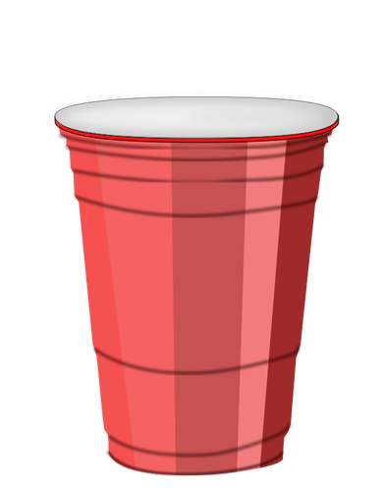
Bubble sort: one pass
Activity 2
Each number is hidden under a cup. The cups need to be sorted with the lowest value on the left.
Cup 1
Cup 2
Cup 3
Cup 4
Cup 5
Cup 6
Cup 7
Cup 8
Cup 9
43
43
21
21
2
2
50
50
3
3
80
80
35
35
64
64
7
7
Take a list of data to be sorted.
Notes:
Image source: https://publicdomainvectors.org/en/free-clipart/Plastic-cup-vector-drawing/8998.html

Slide 9
Bubble sort: one pass
Activity 2
Each number is hidden under a cup. The cups need to be sorted with the lowest value on the left.
43
43
21
21
2
2
50
50
3
3
80
80
35
35
64
64
7
7
Here is the initial order of the cups. However, when you are executing a bubble sort you will only be comparing two items at a time.
Notes:
Image source: https://publicdomainvectors.org/en/free-clipart/Plastic-cup-vector-drawing/8998.html

Slide 10
Bubble sort: one pass
Activity 2
Each number is hidden under a cup. The cups need to be sorted with the lowest value on the left.
43
43
21
21
2
2
50
50
3
3
80
80
35
35
64
64
7
7
current
Start from the first item in the list.
Notes:
Image source: https://publicdomainvectors.org/en/free-clipart/Plastic-cup-vector-drawing/8998.html

Slide 11
Bubble sort: one pass
Activity 2
Each number is hidden under a cup. The cups need to be sorted with the lowest value on the left.
43
43
21
21
2
2
50
50
3
3
80
80
35
35
64
64
7
7
current
Compare the item at the current position to the one next to it.
Notes:
Image source: https://publicdomainvectors.org/en/free-clipart/Plastic-cup-vector-drawing/8998.html

Slide 12
Bubble sort: one pass
Activity 2
Each number is hidden under a cup. The cups need to be sorted with the lowest value on the left.
Cup 1
Cup 2
43
21
2
2
50
50
3
3
80
80
35
35
64
64
7
7
current
If the item at the current position is greater than the one next to it,
swap the items within the list.
Notes:
Image source: https://publicdomainvectors.org/en/free-clipart/Plastic-cup-vector-drawing/8998.html

Slide 13
Bubble sort: one pass
Activity 2
Each number is hidden under a cup. The cups need to be sorted with the lowest value on the left.
Cup 1
Cup 2
21
43
2
2
50
50
3
3
80
80
35
35
64
64
7
7
current
If the item at the current position is greater than the one next to it,
swap the items within the list.
Notes:
Image source: https://publicdomainvectors.org/en/free-clipart/Plastic-cup-vector-drawing/8998.html

Slide 14
Bubble sort: one pass
Activity 2
Each number is hidden under a cup. The cups need to be sorted with the lowest value on the left.
21
43
2
50
3
80
35
64
7
current
Go to the next item in the list.
Notes:
Image source: https://publicdomainvectors.org/en/free-clipart/Plastic-cup-vector-drawing/8998.html

Slide 15
Bubble sort: one pass
Activity 2
Each number is hidden under a cup. The cups need to be sorted with the lowest value on the left.
21
43
2
50
3
80
35
64
7
current
Compare the item at the current position to the one next to it.
Notes:
Image source: https://publicdomainvectors.org/en/free-clipart/Plastic-cup-vector-drawing/8998.html

Slide 16
Bubble sort: one pass
Activity 2
Each number is hidden under a cup. The cups need to be sorted with the lowest value on the left.
21
43
2
50
3
80
35
64
7
current
If the item at the current position is greater than the one next to it,
swap the items within the list.
Notes:
Image source: https://publicdomainvectors.org/en/free-clipart/Plastic-cup-vector-drawing/8998.html

Slide 17
Bubble sort: one pass
Activity 2
Each number is hidden under a cup. The cups need to be sorted with the lowest value on the left.
21
2
43
50
3
80
35
64
7
current
If the item at the current position is greater than the one next to it,
swap the items within the list.
Notes:
Image source: https://publicdomainvectors.org/en/free-clipart/Plastic-cup-vector-drawing/8998.html

Slide 18
Bubble sort: one pass
Activity 2
Each number is hidden under a cup. The cups need to be sorted with the lowest value on the left.
21
2
43
50
3
80
35
64
7
current
Go to the next item in the list.
Notes:
Image source: https://publicdomainvectors.org/en/free-clipart/Plastic-cup-vector-drawing/8998.html

Slide 19
Bubble sort: one pass
Activity 2
Each number is hidden under a cup. The cups need to be sorted with the lowest value on the left.
21
2
43
50
3
80
35
64
7
current
Compare the item at the current position to the one next to it.
Notes:
Image source: https://publicdomainvectors.org/en/free-clipart/Plastic-cup-vector-drawing/8998.html

Slide 20
Bubble sort: one pass
Activity 2
Each number is hidden under a cup. The cups need to be sorted with the lowest value on the left.
21
2
43
50
3
80
35
64
7
current
If the item at the current position is greater than the one next to it,
swap the items within the list.
Notes:
Image source: https://publicdomainvectors.org/en/free-clipart/Plastic-cup-vector-drawing/8998.html

Slide 21
Bubble sort: one pass
Activity 2
Each number is hidden under a cup. The cups need to be sorted with the lowest value on the left.
21
2
43
50
3
80
35
64
7
current
Go to the next item in the list.
Notes:
Image source: https://publicdomainvectors.org/en/free-clipart/Plastic-cup-vector-drawing/8998.html

Slide 22
Bubble sort: one pass
Activity 2
Each number is hidden under a cup. The cups need to be sorted with the lowest value on the left.
21
2
43
50
3
80
35
64
7
current
Compare the item at the current position to the one next to it.
Notes:
Image source: https://publicdomainvectors.org/en/free-clipart/Plastic-cup-vector-drawing/8998.html

Slide 23
Bubble sort: one pass
Activity 2
Each number is hidden under a cup. The cups need to be sorted with the lowest value on the left.
21
2
43
50
3
80
35
64
7
current
If the item at the current position is greater than the one next to it,
swap the items within the list.
Notes:
Image source: https://publicdomainvectors.org/en/free-clipart/Plastic-cup-vector-drawing/8998.html

Slide 24
Bubble sort: one pass
Activity 2
Each number is hidden under a cup. The cups need to be sorted with the lowest value on the left.
21
2
43
3
50
80
35
64
7
current
If the item at the current position is greater than the one next to it,
swap the items within the list.
Notes:
Image source: https://publicdomainvectors.org/en/free-clipart/Plastic-cup-vector-drawing/8998.html

Slide 25
Bubble sort: one pass
Activity 2
Each number is hidden under a cup. The cups need to be sorted with the lowest value on the left.
current
Go to the next item in the list.
Notes:
Image source: https://publicdomainvectors.org/en/free-clipart/Plastic-cup-vector-drawing/8998.html

Slide 26
Bubble sort: one pass
Activity 2
Each number is hidden under a cup. The cups need to be sorted with the lowest value on the left.
21
2
43
3
50
80
35
64
7
current
Compare the item at the current position to the one next to it.
Notes:
Image source: https://publicdomainvectors.org/en/free-clipart/Plastic-cup-vector-drawing/8998.html

Slide 27
Bubble sort: one pass
Activity 2
Each number is hidden under a cup. The cups need to be sorted with the lowest value on the left.
21
2
43
3
50
80
35
64
7
current
If the item at the current position is greater than the one next to it,
swap the items within the list.
Notes:
Image source: https://publicdomainvectors.org/en/free-clipart/Plastic-cup-vector-drawing/8998.html

Slide 28
Bubble sort: one pass
Activity 2
Each number is hidden under a cup. The cups need to be sorted with the lowest value on the left.
21
2
43
3
50
80
35
64
7
current
Go to the next item in the list.
Notes:
Image source: https://publicdomainvectors.org/en/free-clipart/Plastic-cup-vector-drawing/8998.html

Slide 29
Bubble sort: one pass
Activity 2
Each number is hidden under a cup. The cups need to be sorted with the lowest value on the left.
21
2
43
3
50
80
35
64
7
current
Compare the item at the current position to the one next to it.
Notes:
Image source: https://publicdomainvectors.org/en/free-clipart/Plastic-cup-vector-drawing/8998.html

Slide 30
Bubble sort: one pass
Activity 2
Each number is hidden under a cup. The cups need to be sorted with the lowest value on the left.
21
2
43
3
50
80
35
64
7
current
If the item at the current position is greater than the one next to it,
swap the items within the list.
Notes:
Image source: https://publicdomainvectors.org/en/free-clipart/Plastic-cup-vector-drawing/8998.html

Slide 31
Bubble sort: one pass
Activity 2
Each number is hidden under a cup. The cups need to be sorted with the lowest value on the left.
21
2
43
3
50
35
80
64
7
current
If the item at the current position is greater than the one next to it,
swap the items within the list.
Notes:
Image source: https://publicdomainvectors.org/en/free-clipart/Plastic-cup-vector-drawing/8998.html

Slide 32
Bubble sort: one pass
Activity 2
Each number is hidden under a cup. The cups need to be sorted with the lowest value on the left.
21
2
43
3
50
35
80
64
7
current
Go to the next item in the list.
Notes:
Image source: https://publicdomainvectors.org/en/free-clipart/Plastic-cup-vector-drawing/8998.html

Slide 33
Bubble sort: one pass
Activity 2
Each number is hidden under a cup. The cups need to be sorted with the lowest value on the left.
21
2
43
3
50
35
80
64
7
current
Compare the item at the current position to the one next to it.
Notes:
Image source: https://publicdomainvectors.org/en/free-clipart/Plastic-cup-vector-drawing/8998.html

Slide 34
Bubble sort: one pass
Activity 2
Each number is hidden under a cup. The cups need to be sorted with the lowest value on the left.
21
2
43
3
50
35
80
64
7
current
If the item at the current position is greater than the one next to it,
swap the items within the list.
Notes:
Image source: https://publicdomainvectors.org/en/free-clipart/Plastic-cup-vector-drawing/8998.html

Slide 35
Bubble sort: one pass
Activity 2
Each number is hidden under a cup. The cups need to be sorted with the lowest value on the left.
21
2
43
3
50
35
64
80
7
current
If the item at the current position is greater than the one next to it,
swap the items within the list.
Notes:
Image source: https://publicdomainvectors.org/en/free-clipart/Plastic-cup-vector-drawing/8998.html

Slide 36
Bubble sort: one pass
Activity 2
Each number is hidden under a cup. The cups need to be sorted with the lowest value on the left.
21
2
43
3
50
35
64
80
7
current
Go to the next item in the list.
Notes:
Image source: https://publicdomainvectors.org/en/free-clipart/Plastic-cup-vector-drawing/8998.html

Slide 37
Bubble sort: one pass
Activity 2
Each number is hidden under a cup. The cups need to be sorted with the lowest value on the left.
21
2
43
3
50
35
64
80
7
current
Compare the item at the current position to the one next to it.
Notes:
Image source: https://publicdomainvectors.org/en/free-clipart/Plastic-cup-vector-drawing/8998.html

Slide 38
Bubble sort: one pass
Activity 2
Each number is hidden under a cup. The cups need to be sorted with the lowest value on the left.
21
2
43
3
50
35
64
80
7
current
If the item at the current position is greater than the one next to it,
swap the items within the list.
Notes:
Image source: https://publicdomainvectors.org/en/free-clipart/Plastic-cup-vector-drawing/8998.html

Slide 39
Bubble sort: one pass
Activity 2
Each number is hidden under a cup. The cups need to be sorted with the lowest value on the left.
21
2
43
3
50
35
64
7
80
current
If the item at the current position is greater than the one next to it,
swap the items within the list.
Notes:
Image source: https://publicdomainvectors.org/en/free-clipart/Plastic-cup-vector-drawing/8998.html

Slide 40
Bubble sort: one pass
Activity 2
Each number is hidden under a cup. The cups need to be sorted with the lowest value on the left.
21
2
43
3
50
35
64
7
80
One pass has now been completed. If any swaps were made in this pass then keep passing through the list until no swaps are made.
Notes:
Image source: https://publicdomainvectors.org/en/free-clipart/Plastic-cup-vector-drawing/8998.html

Slide 41
Bubble sort
Activity 2
Original list
43
21
2
50
3
80
35
64
7
List after one pass
21
2
43
3
50
35
64
7
80
A single pass results in the largest element reaching its final position at the end of the list, since it will always be greater than the element it is next to.
This means that the next pass doesn’t need to check the final pair of elements as you know the largest element is in the right place.
Notes:
Image source: https://publicdomainvectors.org/en/free-clipart/Plastic-cup-vector-drawing/8998.html

Slide 42
Algorithm for one pass of a bubble sort
Activity 2
The instructions for performing one pass of a bubble sort can be written as:
Take a list of data to be sorted.
Repeat steps a-c for all the items in the list, starting from the first one:
Compare the item at the current position to the one next to it.
If the item at the current position is greater than the one next to it, swap the items within the list.
Go to the next item in the list.
Pass

Slide 43

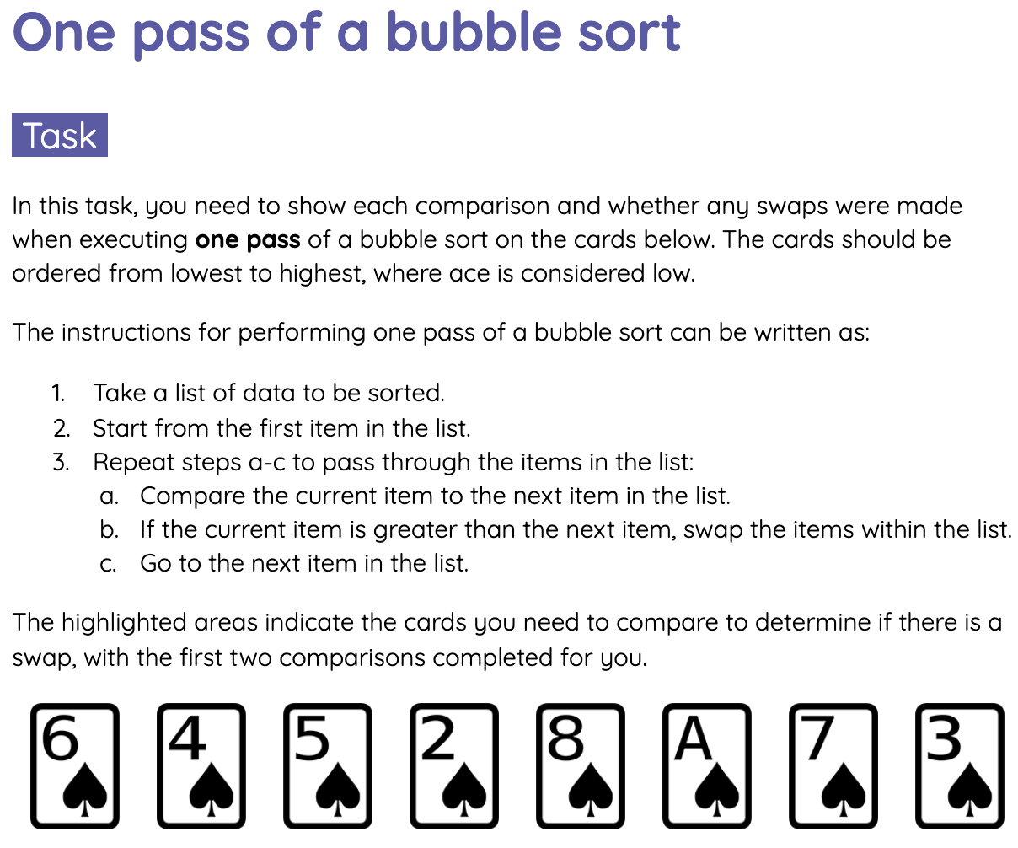
One pass of a bubble sort
Activity 3
You are now going to perform one pass of a bubble sort on a list of cards.
Fill in the table on the Activity 3 worksheet to show the order of the cards after each comparison.

Slide 44

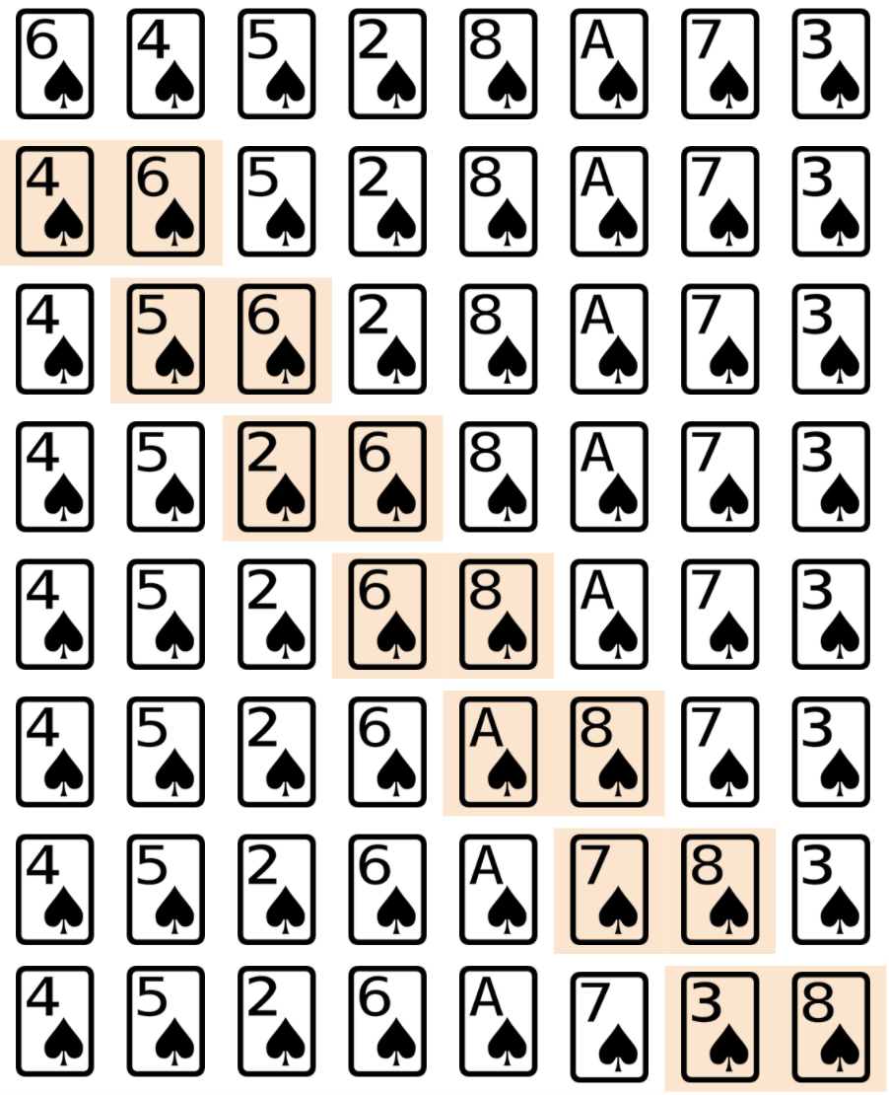
One pass of a bubble sort - Solution
Activity 3

Slide 45
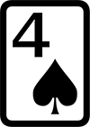
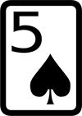
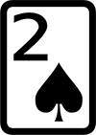
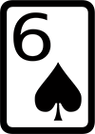
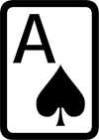
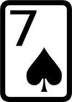
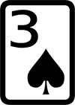
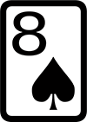
Comparing elements with bubble sort
Activity 4
In the last activity, your cards should have been in this order after one pass:
It should have taken you 7 comparisons to pass over these 8 cards.
The number of comparisons made in a single pass is always equal to the number of pairs you pass over i.e. the number of elements - 1.

Slide 46
Comparing elements with bubble sort
Activity 4
To fully execute a bubble sort, you need to keep passing through the list until all the elements are in order.
How do you know that the list has been sorted after you’ve finished a pass?
If no swaps were made during a single pass, that means that none of the elements are out of order and the algorithm can stop executing.

Slide 47
Algorithm for a complete bubble sort
Activity 4
The instructions for executing a bubble sort in full can be written as:
Take a list of data to be sorted.
Repeat step 1 (the pass) until no swaps are made:
Repeat steps a-c for all the items in the list, starting from the first one:
Compare the item at the current position to the one next to it.
If the item at the current position is greater than the one next to it, swap the items within the list.
Go to the next item in the list.
Pass

Slide 48
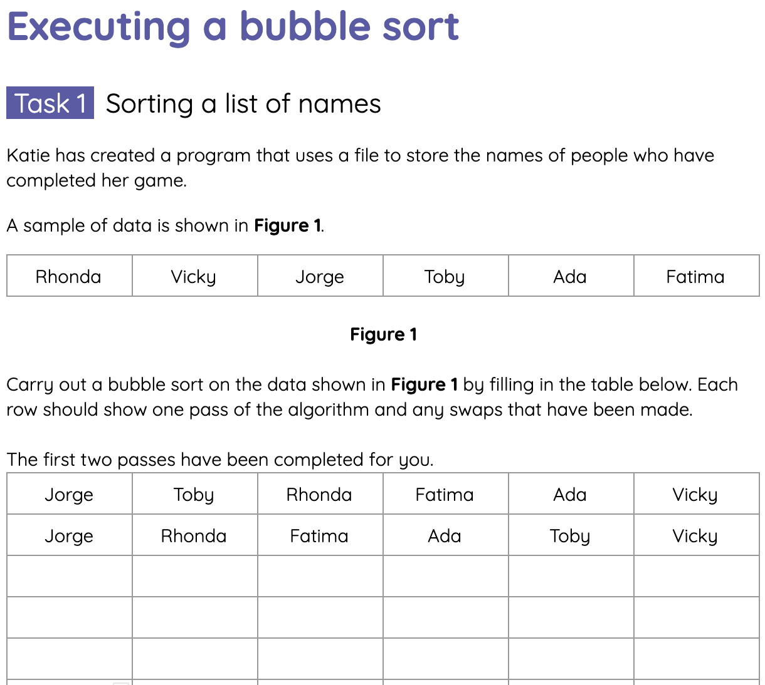
Executing a bubble sort
Activity 5
Complete the tasks on the Activity 5 worksheet for executing a bubble sort.

Slide 49
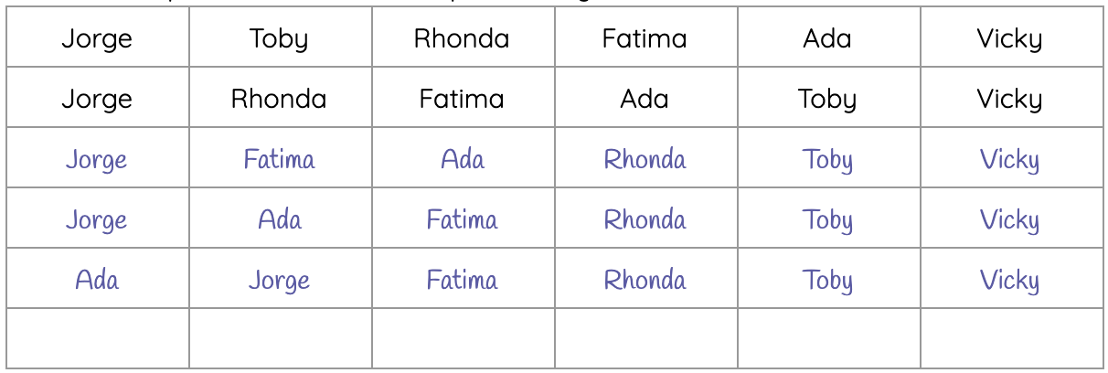
Executing a bubble sort - Task 1 Solution
Activity 5
Below is the solution for each pass of the bubble sort in the first task:

Slide 50
Executing a bubble sort
Activity 5
You may have noticed in the last activity that after each pass, the next largest value is in its proper place.
This means that you would never need to check the largest value again once a pass has completed.
Therefore, you can reduce the number of comparisons by one after each pass to improve the efficiency of the algorithm.

Slide 51

Summary of bubble sort
Wrap Up
Bubble sort is one of the slowest algorithms for sorting data and performs poorly in real world use, especially on large collections of data.
However, you can improve the efficiency of the bubble sort algorithm by:
Stopping once no swaps were made during a single pass
Reducing the number of comparisons by 1 after each pass

Slide 52
Next lesson
Summary
In this lesson, you…
Identified why computers often need to sort data.
Traversed a list of items, swapping the items that are out of order.
Performed a bubble sort to order a list containing sample data.
Next lesson, you will…
Explore another sorting algorithm, insertion sort.

